Slide 1
MammoGaurd

Slide 2

Breast Cancer
Supervised by:
TA. Aml Talaat
Dr. Alaa Zaki

Slide 3
Our Team
Esraa Mahmod
Abdelaziz Maghraby
Rahma Khodir
Yara Khaled
Sondos Fouad
Asmaa Saad
Eman Mohamed

Slide 4
Outlines
1
Introduction
2
Project Overview
3
Innovative Solution (Mobile APP)
4
AI Technologies
5
UI Design
6
Live Demo
7
Project Schedule
8
Future Work

Slide 5
01
Introduction

Slide 6











Quick look at the Breast Cancer
Breast cancer, identified since ancient Egyptian times, has a high mortality rate in Egypt, often due to limited awareness in Egypt and the Arab world.
Breast cancer predominantly affects women, with the CDC reporting that approximately one in eight women are at risk of developing the disease.
1 IN 8 Women
Will Get Breast Cancer during her lifetime

Slide 7
Quick look at the Breast Cancer
Cancer is typically categorized as malignant or benign, and as invasive or non-invasive. Breast cancer progresses through five distinct stages.
Breast cancer ranges from Stage 0 (localized) to Stage IV (metastasized).
Stage IV is The most dangerous,while Stage 0 offers the highest recovery rate.

Slide 8

Breast Cancer Causes
Genetic
Hormonal
Age/Gender
Personal
History
BRCA mutations greatly increased
risk.
Prolonged estrogen exposure (early periods, hormone therapy).
Older age and female gender increase
risk.
Previous breast cancer or breast disease

Slide 9
Breast Cancer Causes
Family History
Physiological
Reproductive
Lifestyle
Risk increases if close relatives had breast cancer.
Exposure to radiation or harmful chemicals.
Late childbirth, no childbirth, or first child after 30.
High-fat diet, inactivity, alcohol, and smoking.

Slide 10
02
Project Overview

Slide 11
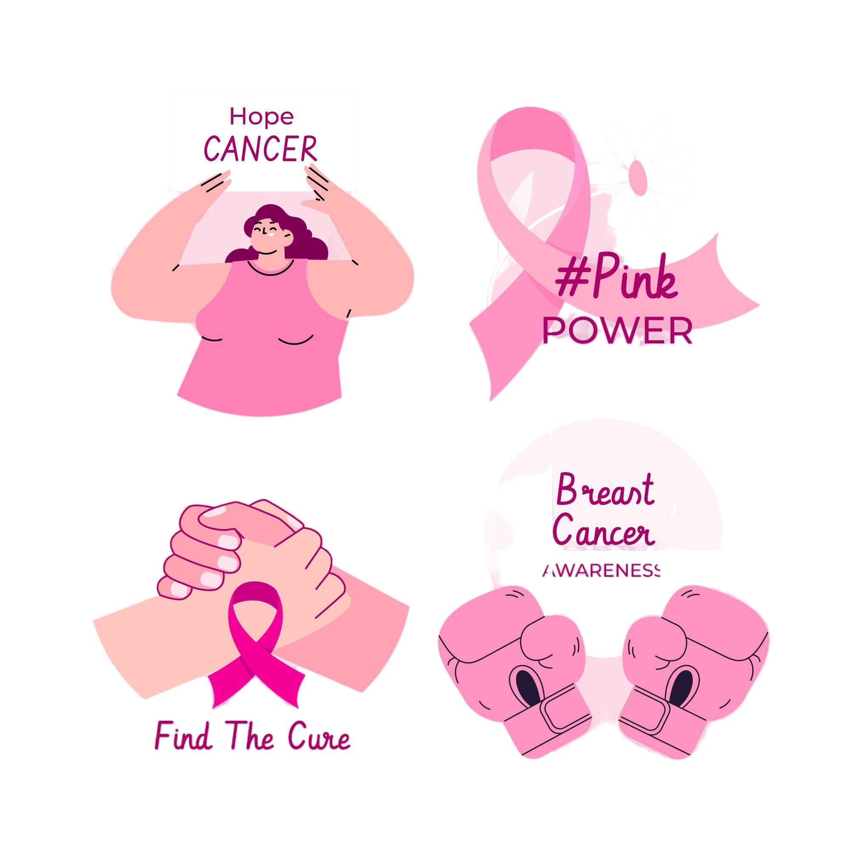
APP Development: Key motivations
MammoGuard raises breast cancer awareness with educational content, self-examination tools, and tips for early detection.
The app empowers users with step-by-step guides for breast self-examination and the ability to schedule medical check-ups directly, promoting proactive health management.

Slide 12
APP Development: Key motivations
Detailed content covers risk factors, symptoms, and diagnostic procedures, aiding informed health decision.
MammoGuard shares survivor stories, fosters community engagement.
allows users to upload breast images for analysis to detect normal, benign, or malignant conditions early.

Slide 13
03
The Innovative Solution
(Why Mobile App)

Slide 14
Why Mobile App
With most people owning mobile phones, apps are widely used, aiding in spreading awareness.
Mobile apps offer a constant presence on users' devices, making them more accessible than web apps.
Mobile apps, optimized for specific platforms, load faster and run smoother than web apps, which rely on browsers

Slide 15
Why Mobile App
Mobile apps use push notifications for instant communication, while web apps often rely on slower methods like email.
Mobile apps can work offline, providing a consistent user experience even without internet, unlike web apps.

Slide 16

Why Flutter ?
Cross-Platform Compatibility.
Single Codebase, Multiple Platforms
Native-like Experience.
Widget-Based System.

Slide 17
04
Breast Cancer Detector (AI Technologies)

Slide 18
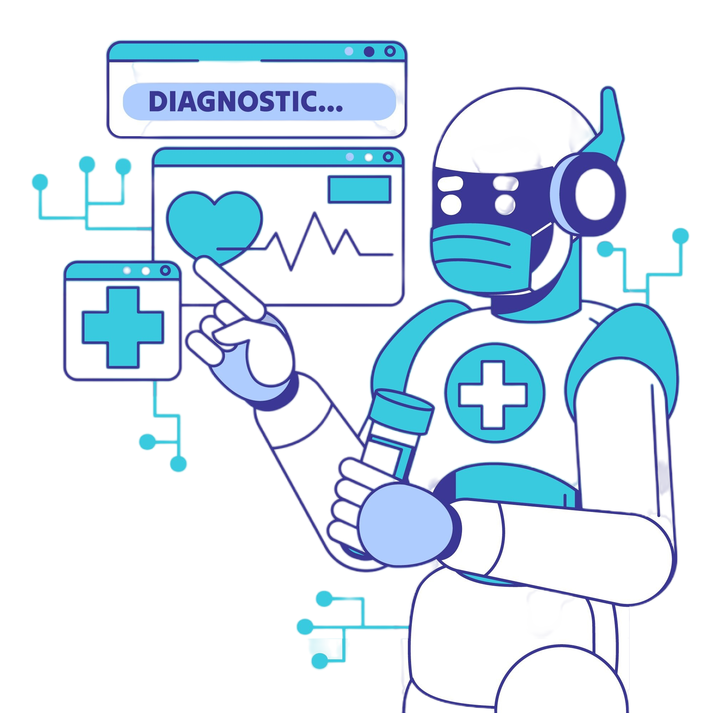
ML Feature :
Automated Image Analysis: ML-based analysis of mammograms or ultrasound scans to detect abnormalities.
User-Friendly Interface: Simple and intuitive design for easy image upload and result visualization.
Continuous Learning: Models that improve over time with new data and updates.

Slide 19
ML Feature :
Convolutional Neural Networks (CNNs) are a class of deep learning models.
CNNs are commonly used in computer vision tasks like image classification, object detection, and facial recognition.
The CNN-based model achieves an accuracy rate of 98%.

Slide 20
CNN Algorithm
CNN
Input Data
Convolutional
Layer
Prediction
Activation Function
Pooling Layer
Flattening
Fully Connected Layers
Output Layer
Training and Backpropagation

Slide 21
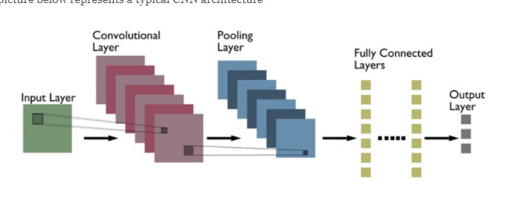
CNN Algorithm
Input Data:
- CNNs process images, typically represented as pixel values.
- Images are divided into smaller regions (patches).

Slide 22
CNN Algorithm
Convolutional Layer:
- Applies filters (kernels) to extract local features (e.g., edges, textures, patterns).
- Multiple filters generate feature maps.

Slide 23
CNN Algorithm
Activation Function:
Applied after convolution (e.g., ReLU) to introduce non-linearity.
- Allows the network to learn complex patterns

Slide 24
CNN Algorithm
Pooling Layer:
- Downsamples feature maps using operations like max pooling or average pooling.
- Reduces spatial dimensions, adds robustness, and decreases parameters.

Slide 25
CNN Algorithm
Flattening:
- Converts pooled feature maps into a 1D vector.
- Prepares data for fully connected layers.

Slide 26
CNN Algorithm
Fully Connected Layers:
- These layers resemble traditional neural networks.
- Each neuron connects to every neuron in the previous layer.
- Learn high-level patterns and global representations.

Slide 27
CNN Algorithm
Output Layer:
- Binary classification: one node (sigmoid).
- Multi-class classification: multiple nodes (softmax).
- Regression: one or more nodes (linear).

Slide 28
CNN Algorithm
Training and Backpropagation:
- CNNs are trained with labeled data and loss functions (e.g., cross-entropy).
- Backpropagation adjusts weights to minimize loss using gradient descent.

Slide 29
CNN Algorithm
Prediction:
- After training, CNNs can make predictions on new images.
- The input goes through the same layers to produce the final output, such as class probabilities or regression values.

Slide 30
Dataset and Source
Dataset Name: Breast Ultrasound Images Dataset
The dataset includes diverse cases (normal, benign, malignant) among women aged 25-75, enhancing model robustness.
It is split into training (70%), validation (10%), and test (20%) sets for model training and evaluation.

Slide 31
Why Flask
Simplicity: Flask simplifies building ML applications.
RESTful API support: Flask integrates smoothly with RESTful APIs.
Scalability: Flask scales ML applications efficiently.

Slide 32
Why Flask
Integration with ML libraries: Flask works well with TensorFlow and Scikit-learn.
Active community: Flask has a supportive developer community.

Slide 33
04
UI Design

Slide 34


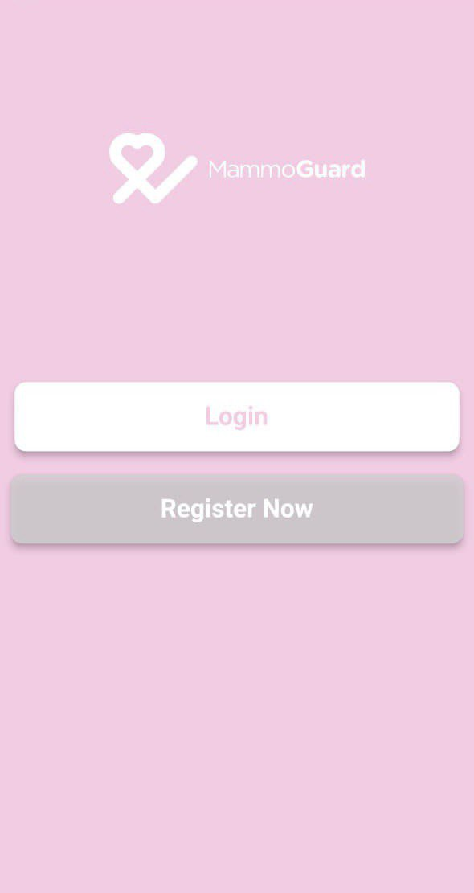
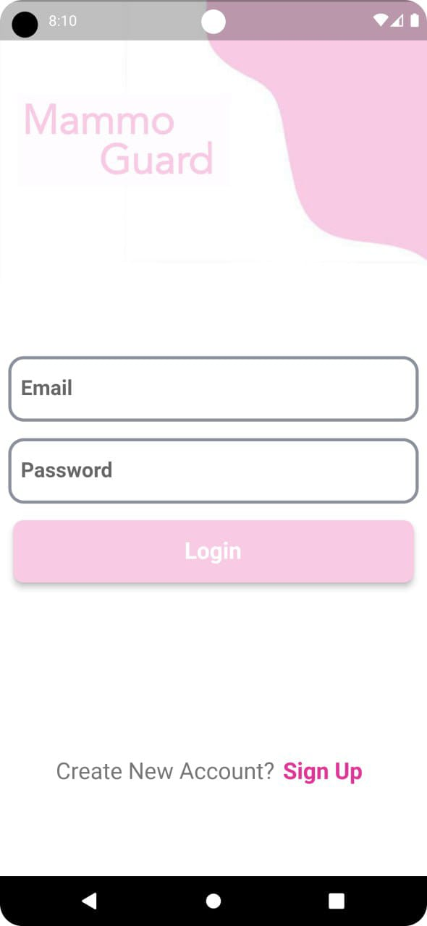
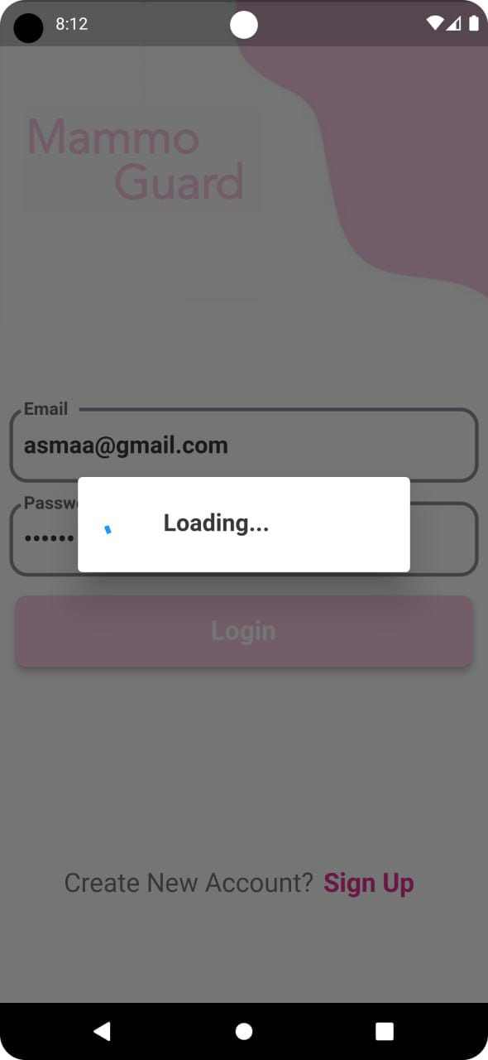

Slide 35
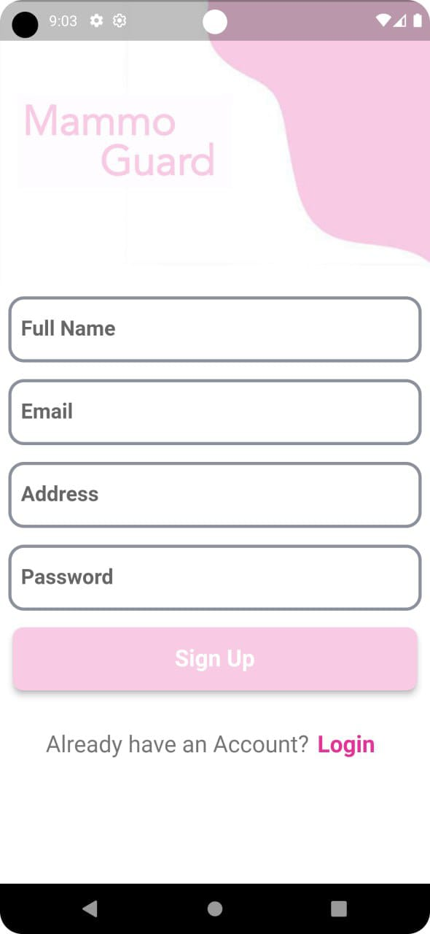
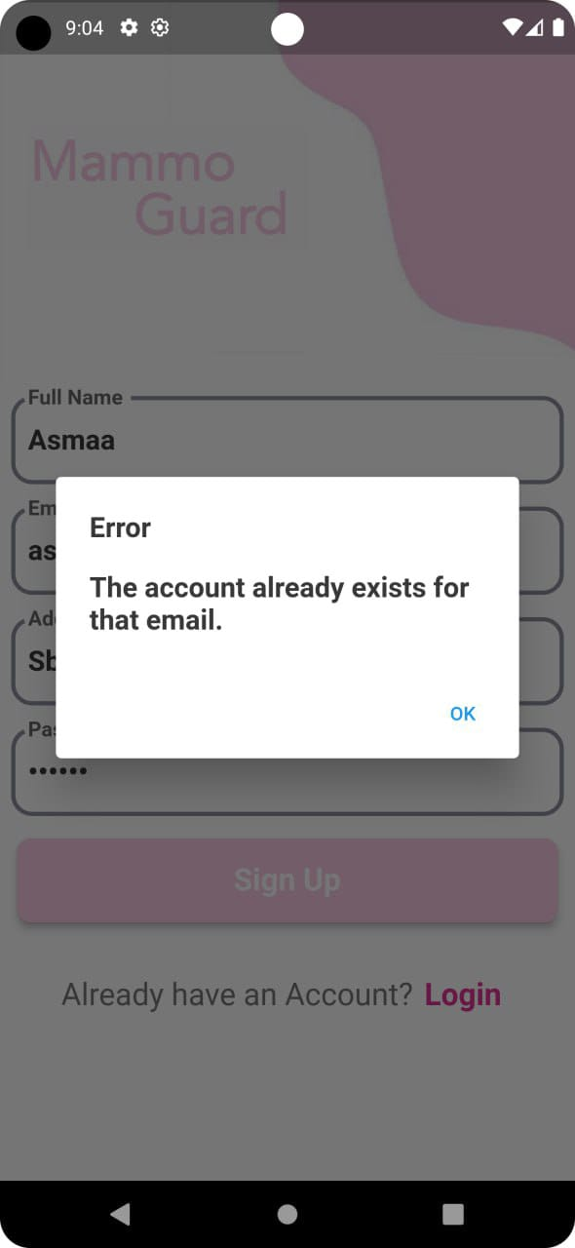
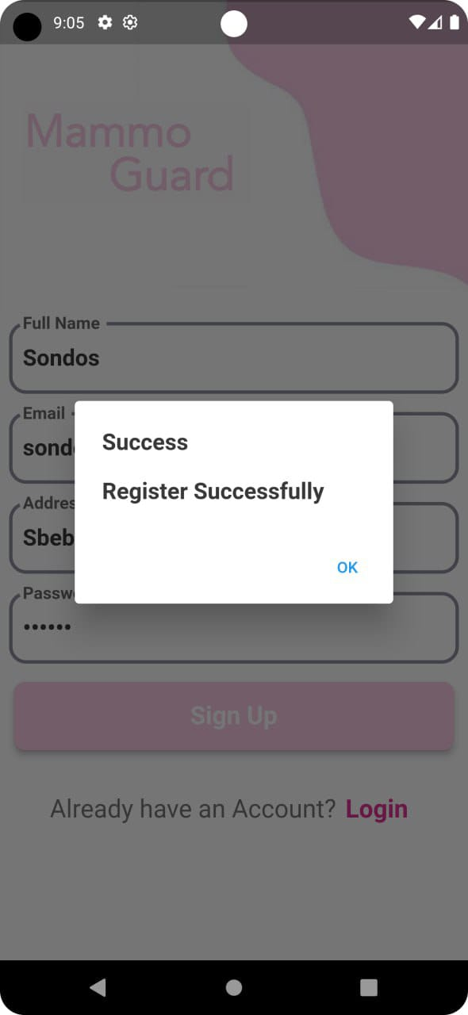

Slide 36
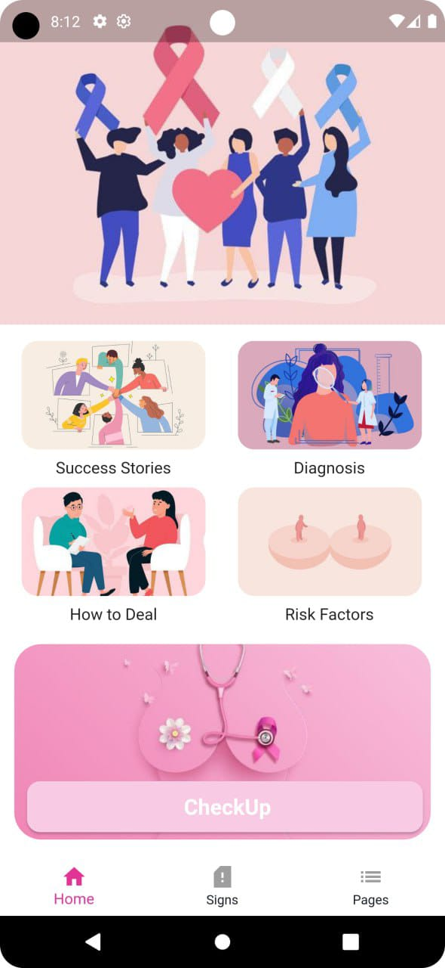
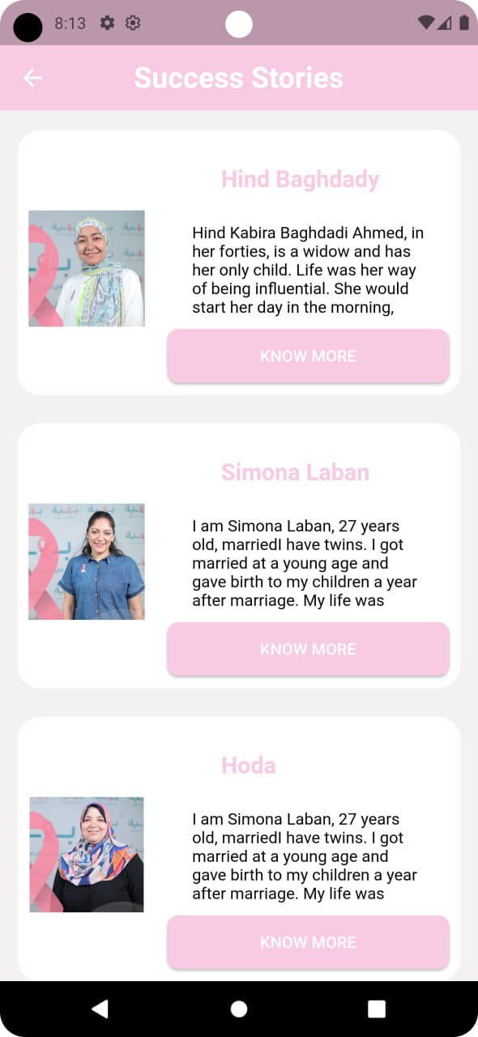
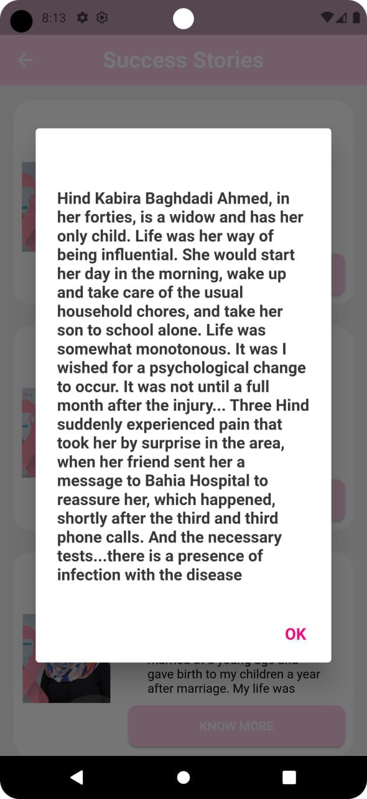

Slide 37
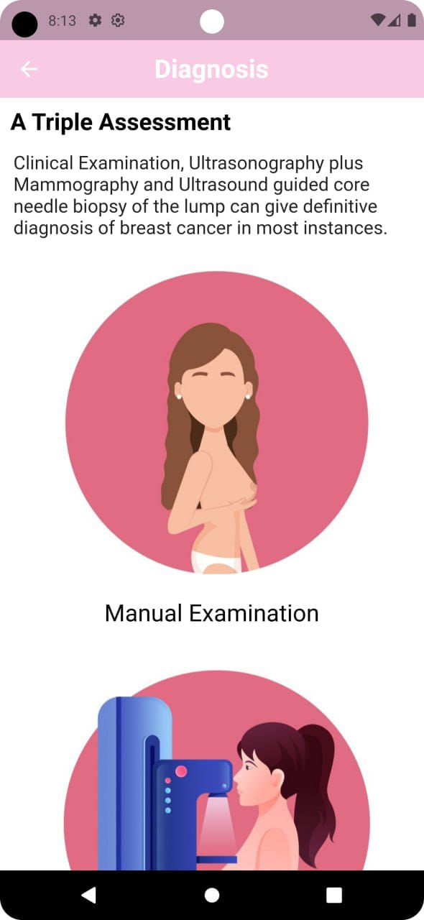
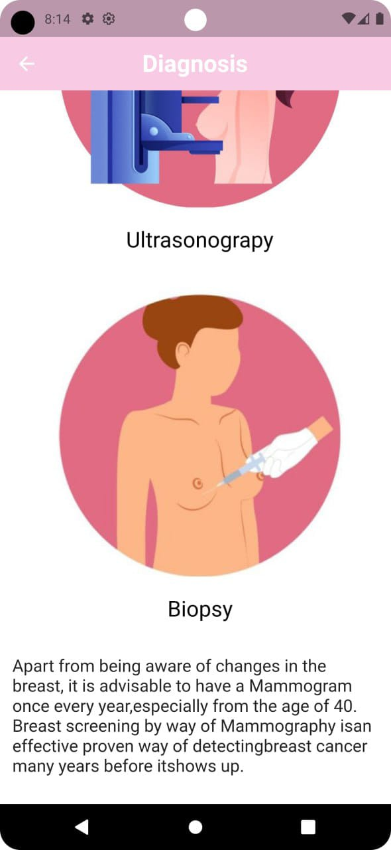

Slide 38
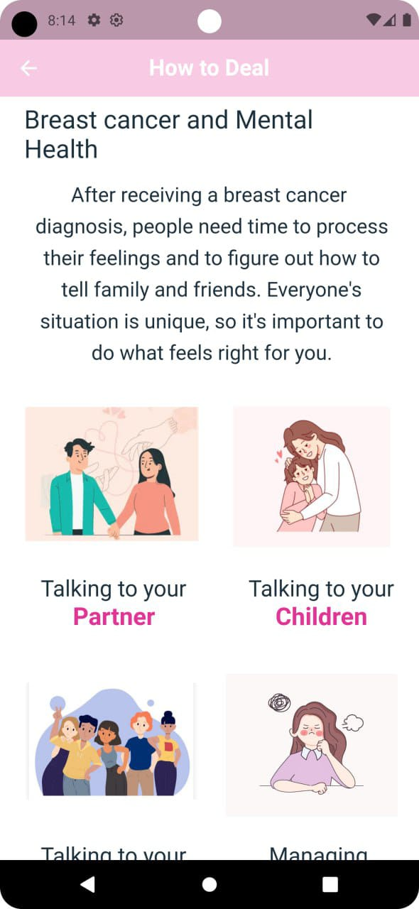
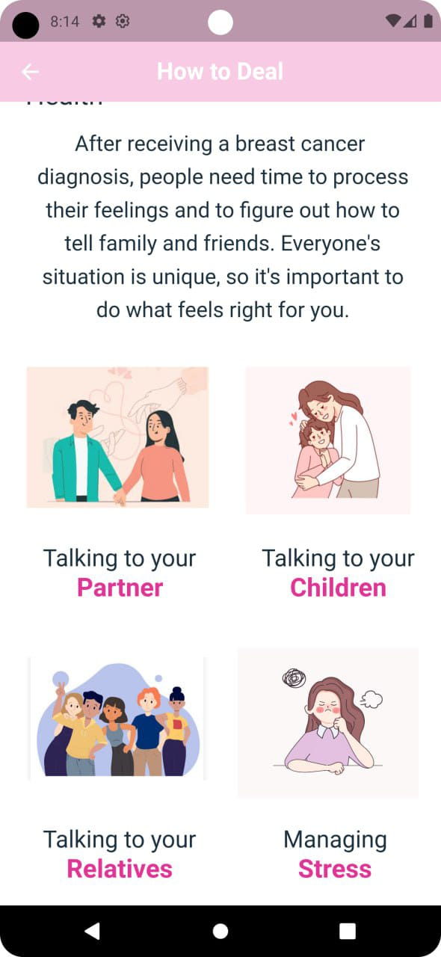

Slide 39
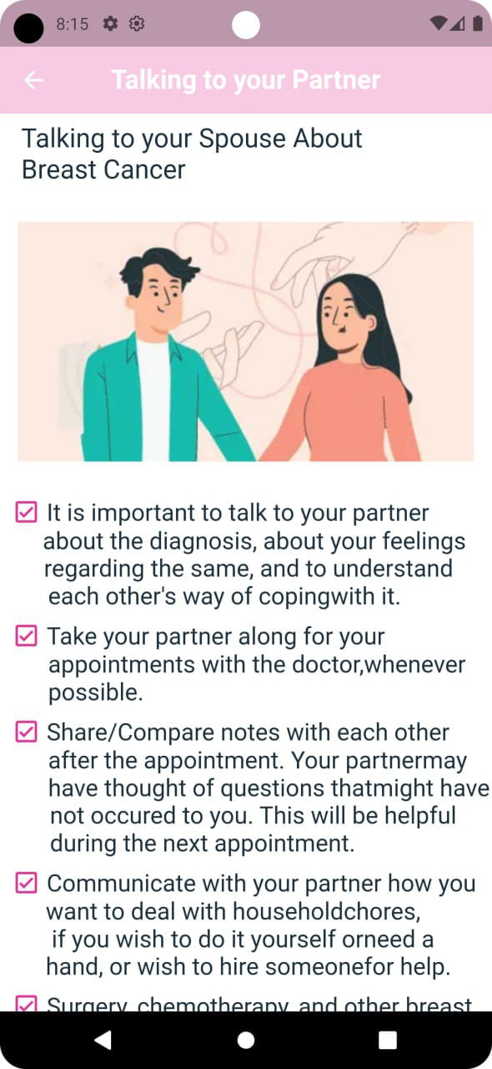
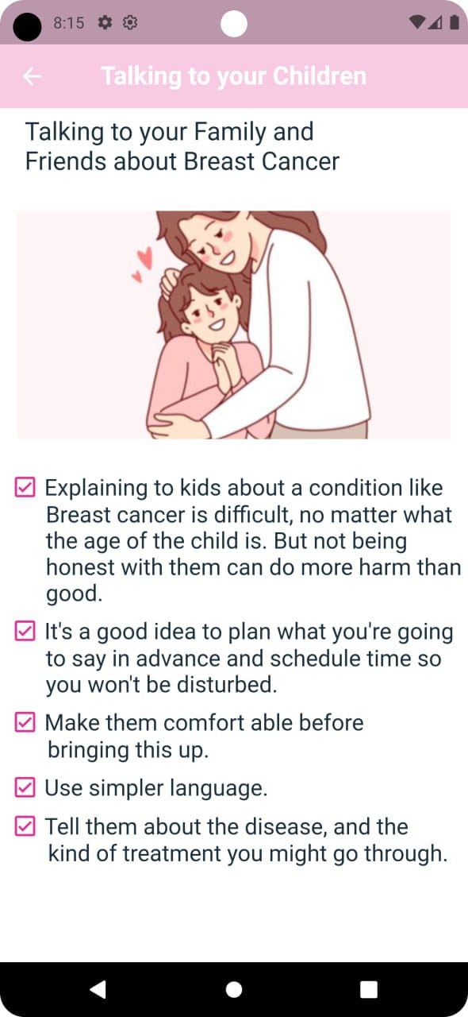

Slide 40
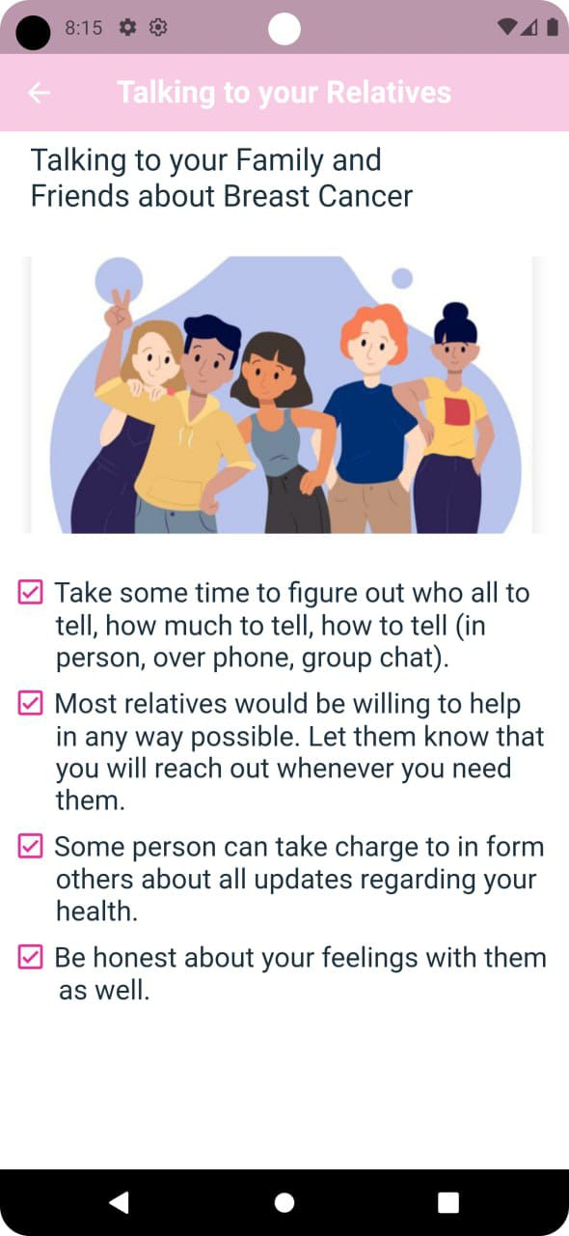
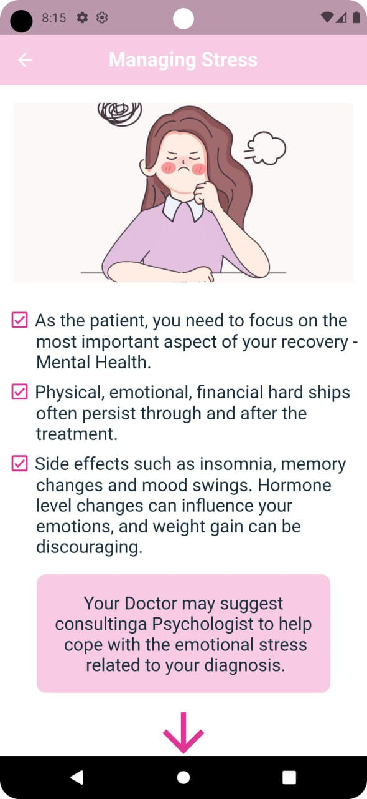
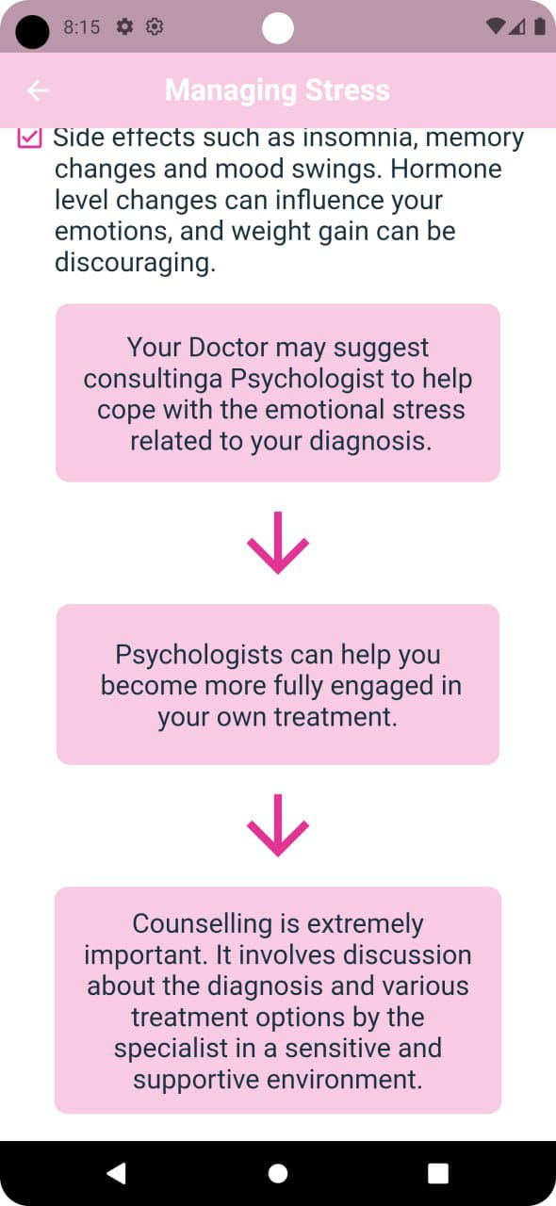

Slide 41
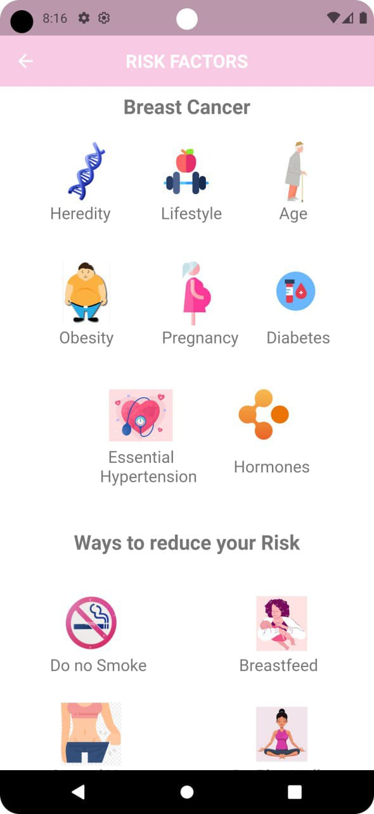

Slide 42
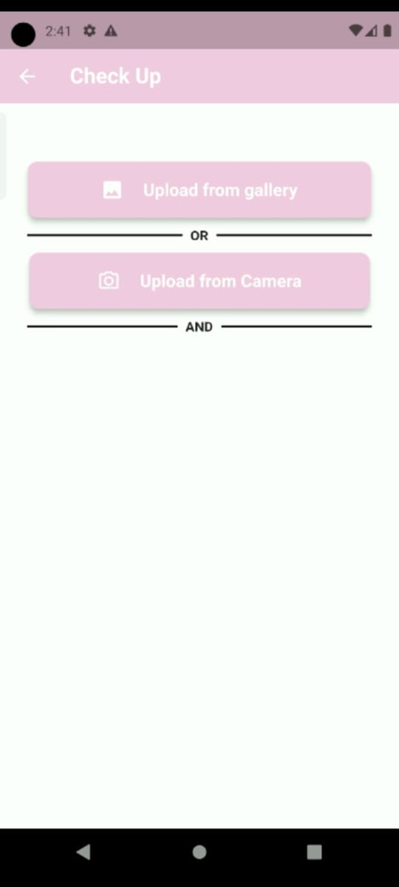
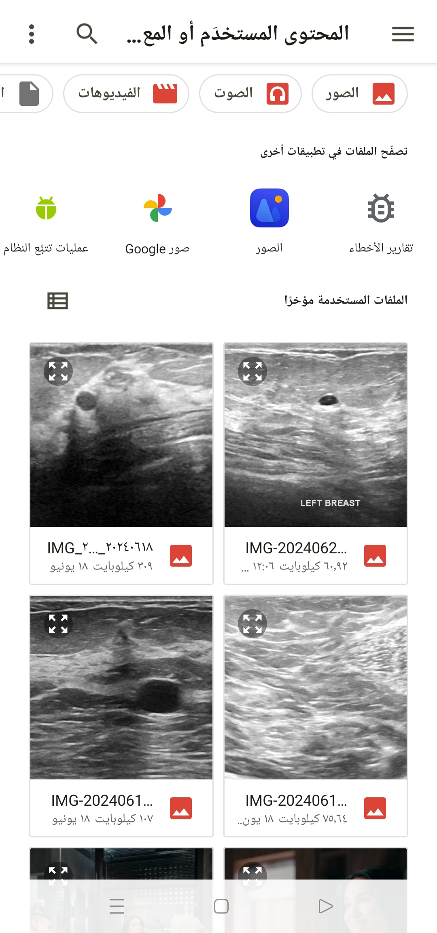
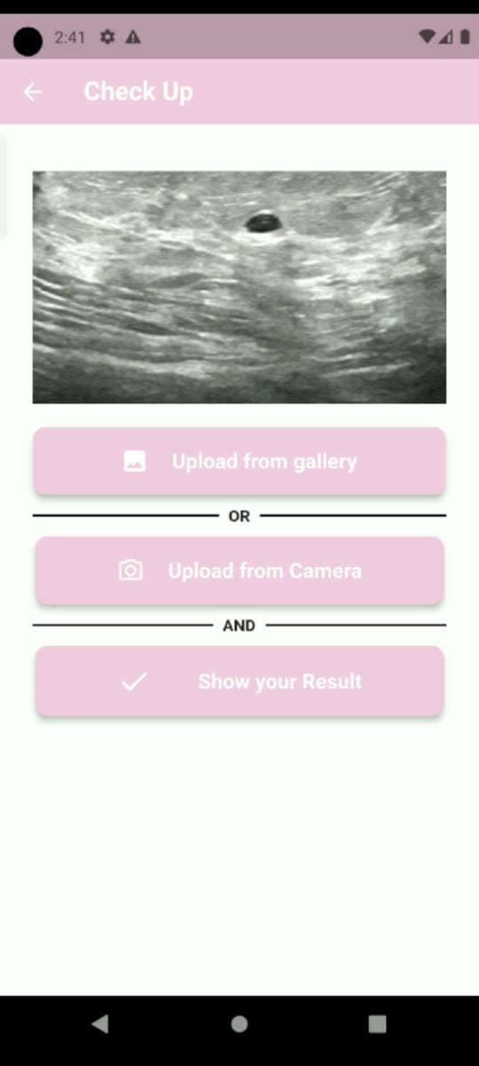

Slide 43
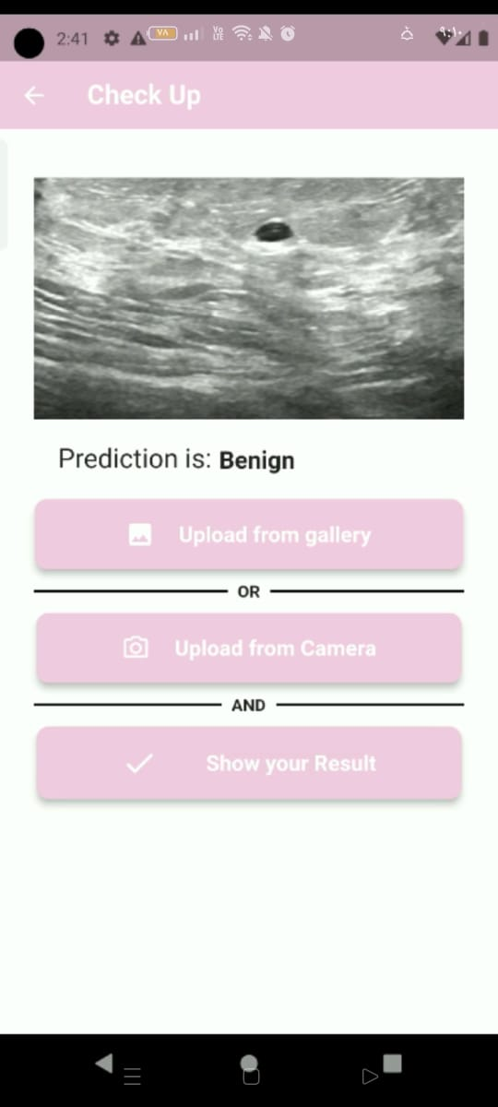

Slide 44
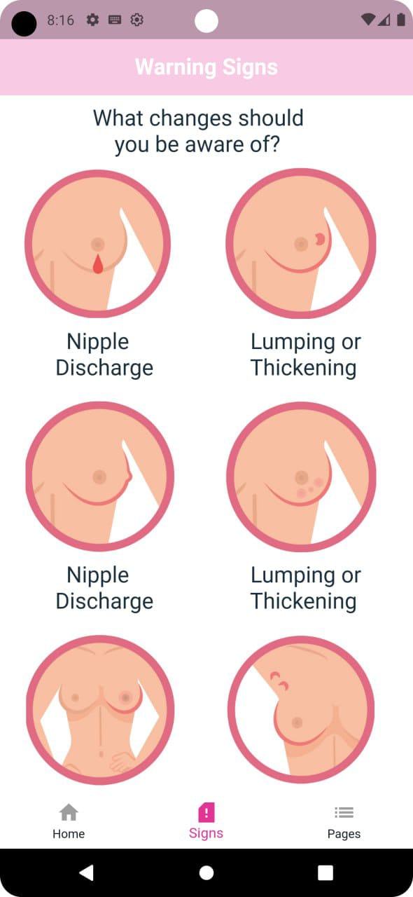
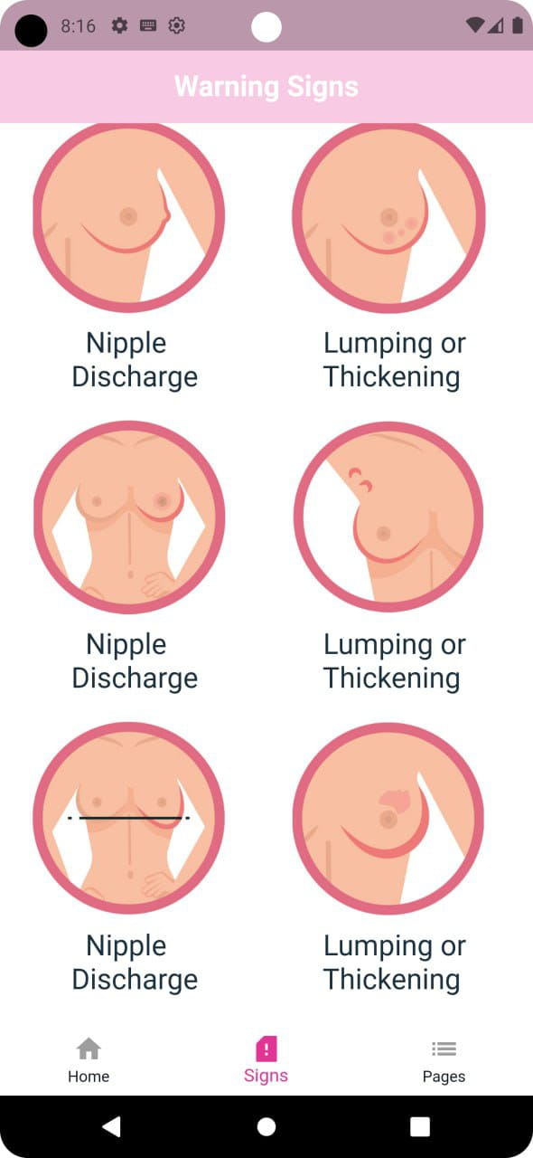

Slide 45
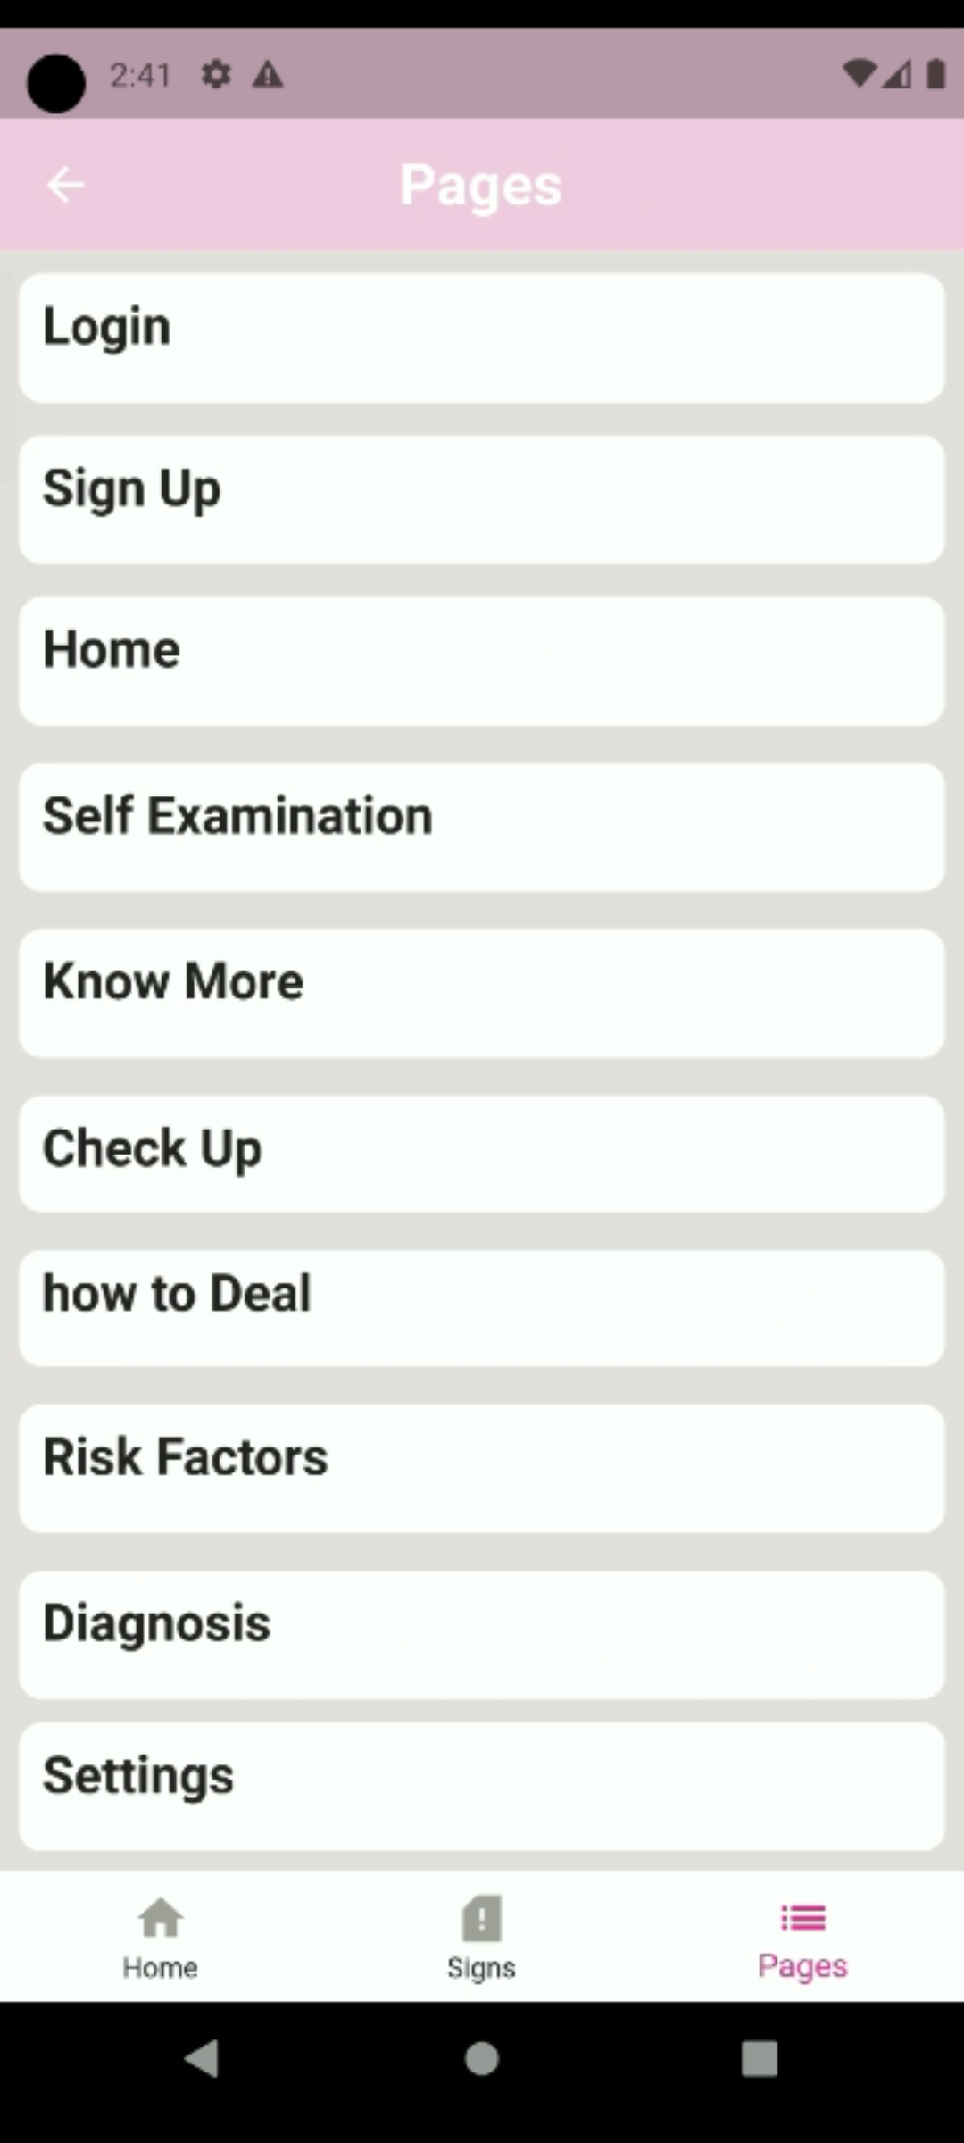
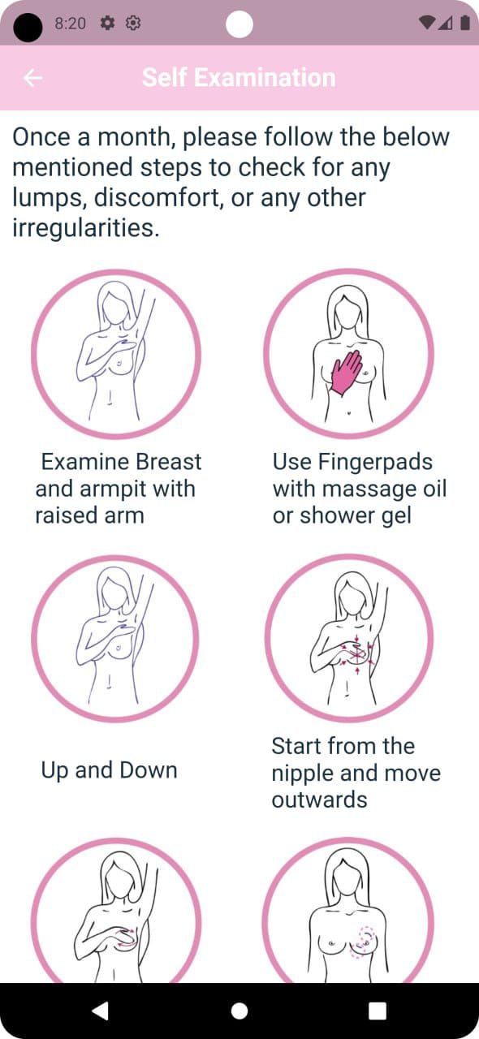
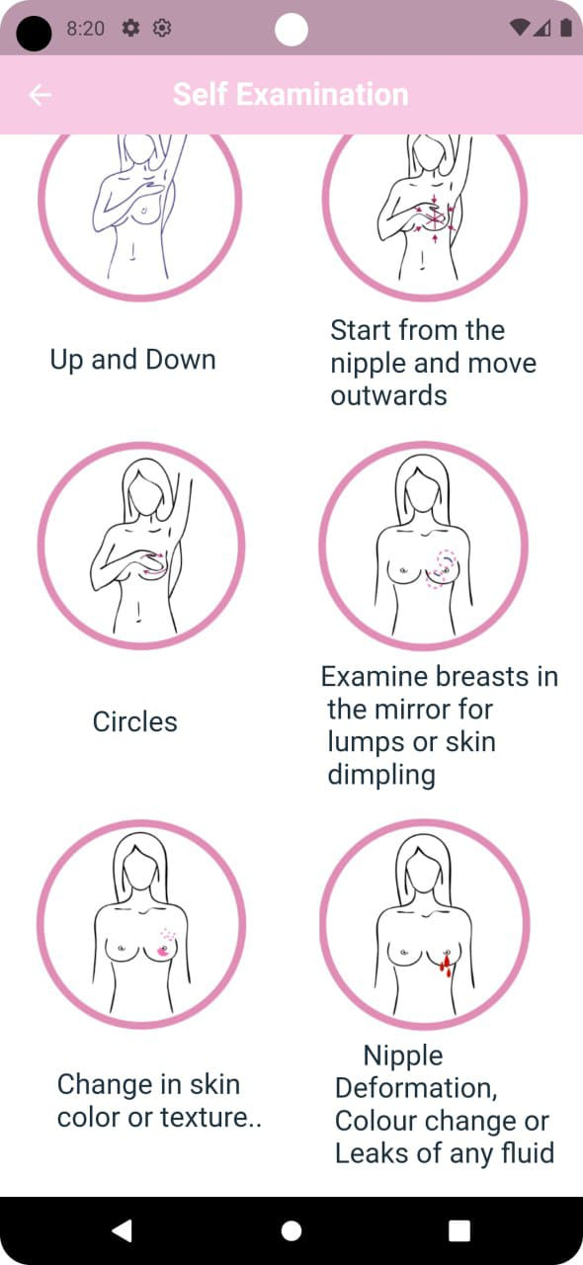

Slide 46
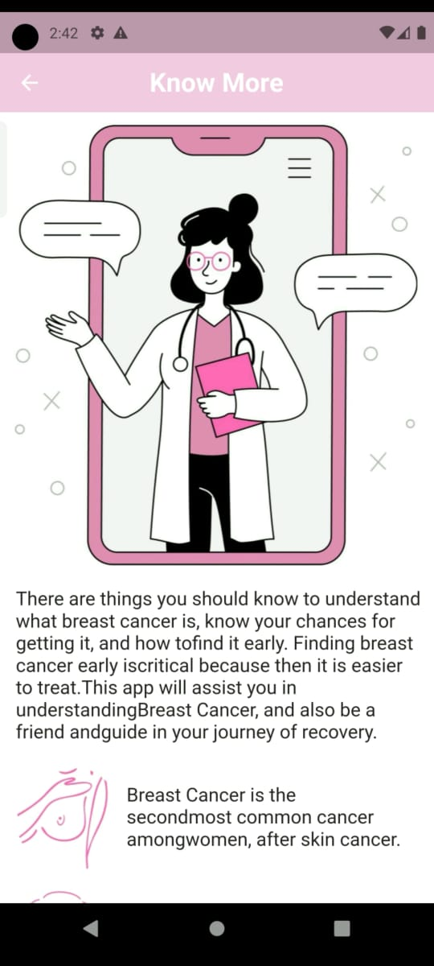
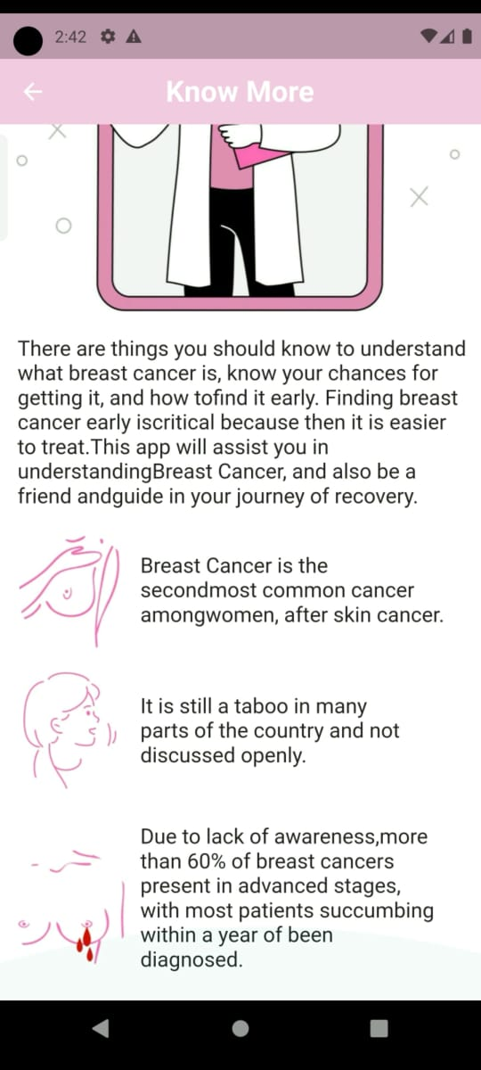

Slide 47
05
Demo

Slide 48




Slide 49
06
Project Schedule

Slide 50
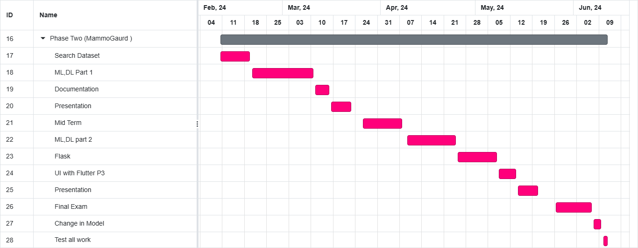

Project Schedule

Slide 51
07
Future Work

Slide 52
Future Work
Enable the app to access location data to guide the user to the nearest treatment facility.
Provide a feature for users to communicate with doctors through a virtual clinic.
Allow users to upload direct images of the affected area without needing to input Ultrasound images

Slide 53
Thank You !

